Slide 1
Expressing one number as a percentage of another
Understanding multiplicative relationships: percentages and proportionality

Slide 2
how to use Oak lessons

Slide 3
I can describe one number as a percentage of another.

Slide 4
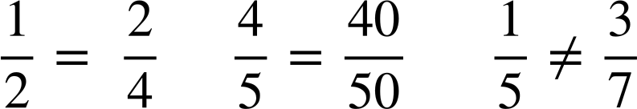
Two fractions are equivalent if they have the same value.
Example
Example
Non example

Slide 5

Expressing one number as a percentage of another
Writing any fraction as a percentage
Writing any number as a percentage of another

Slide 6
Writing any fraction as a percentage
Percent comes from the Latin phrase “per centum” meaning “by the hundred”.
A hundred square is a helpful way to show a percentage, as the total represents 100%.

Slide 7
Writing any fraction as a percentage
Given decimals, percentages and fractions show proportion, we are able to interchange between them.
What do you think 1% looks like on this hundred grid?

Slide 8
Writing any fraction as a percentage
Only 1 square filled in
It can be any square filled in, as it still represents 1%.

Slide 9
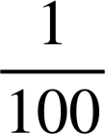
Writing any fraction as a percentage
What do you think 1% is as a fraction?
1% simply means it is 1 part per 100 or

Slide 10
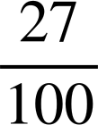
Writing any fraction as a percentage
What percentage and fraction is shaded?
27% as a percentage
As each square represents 1% and we have 27 squares shaded.
As a fraction
27 shaded
Out of 100

Slide 11
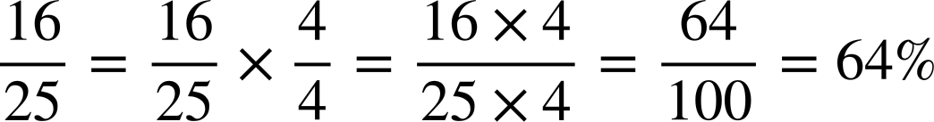
Writing any fraction as a percentage
Making the denominator of a fraction 100 allows us to change a fraction to a percentage easily, without the need of hundred grids.
For example, write as a percentage.
Now the denominator is 100, we have the percentage.
To make the denominator 100, we can multiply by

Slide 12
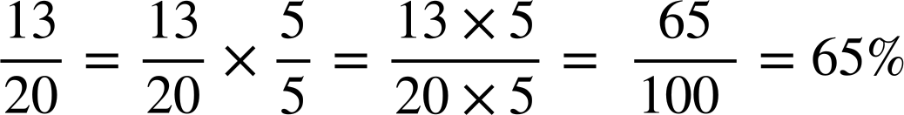
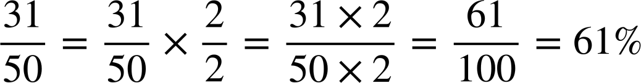
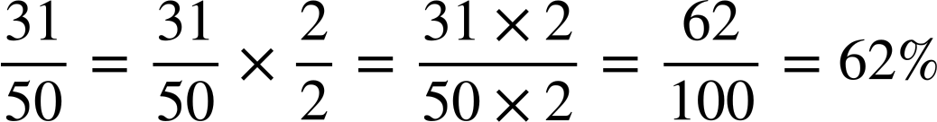
Writing any fraction as a percentage
Write as a percentage.
Write as a percentage

Slide 13
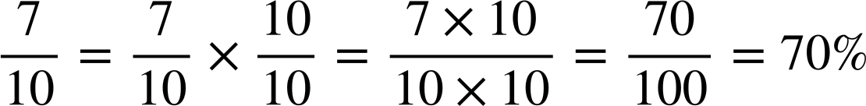
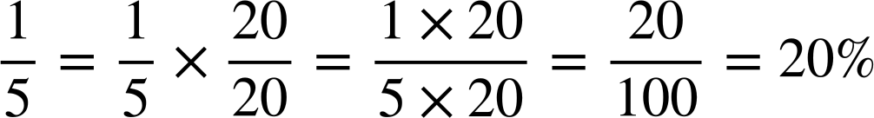
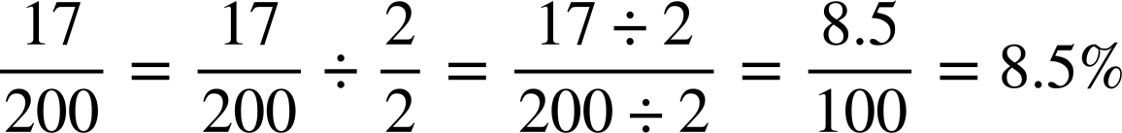
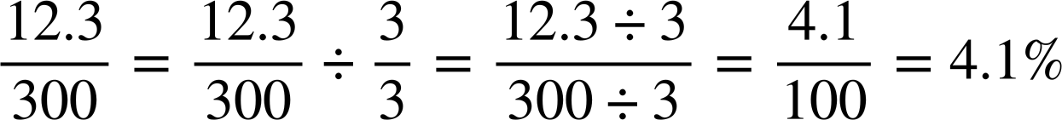
Writing any fraction as a percentage
Convert the following fractions into percentages. Show your working out.
a)
b)
c)
d)

Slide 14
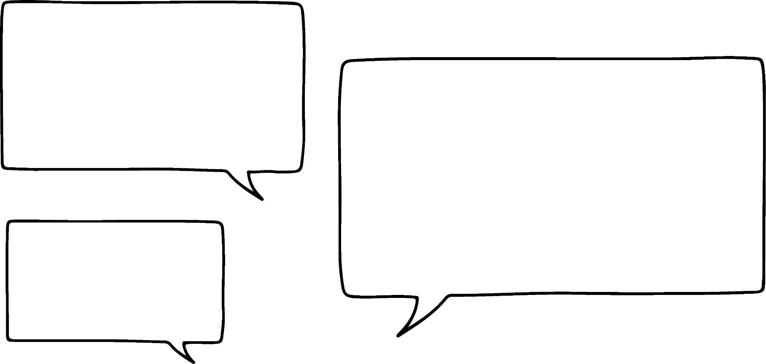


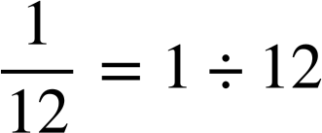
Writing any fraction as a percentage
But what about fractions where the denominator can’t be easily changed into 100? For example
Good point!
What do we do?
Alex
Sofia
Let’s look at the hundred square grid and see if we can find another way.

Slide 15
Writing any fraction as a percentage
As a percentage, we know this represents 1% as there is 1 shaded out of 100.

Slide 16
Writing any fraction as a percentage
1
What would this be as a decimal if we know the whole grid represents 1?

Slide 17
Writing any fraction as a percentage
Each would be 0.01
0.01 is equivalent to 1%
Using this fact we can convert any fraction into a decimal and then a decimal into a percentage.
1

Slide 18
Writing any fraction as a percentage
So knowing 0.01 is equivalent to 1%, we can convert any fraction to a decimal which then can be converted to a percentage.
Can we change
into a percentage please?
Alex

Slide 19
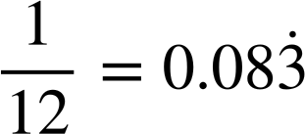
Writing any fraction as a percentage
Using short division we can work out the decimal of the following fraction.
.
3
0
0
8
3…
12 1
.
4
4
1
10
0
0
0
0
as a percentage is 8.3% (correct to 1 d.p.)

Slide 20
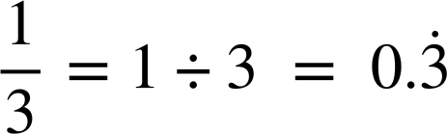
Writing any fraction as a percentage
What is as a percentage to 1 decimal place?
.
0
3
3
3…
.
3 1
1
1
1
0
0
0
This means as a percentage is 33.3% (1 d.p.)

Slide 21
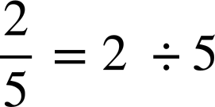
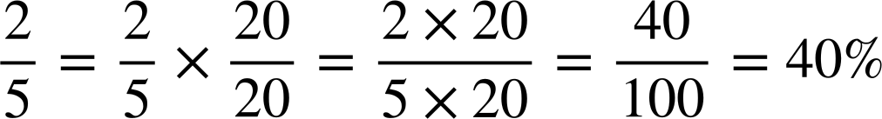

Writing any fraction as a percentage
Three students convert into a percentage. Who is correct?
Andeep
Alex
Sam
.
.
0
4
0
4
5 2
5 2
.
0
.
0
2
2
Alex and Andeep are correct. Sam needed to multiply 0.4 by 100 to convert to a percentage.

Slide 22
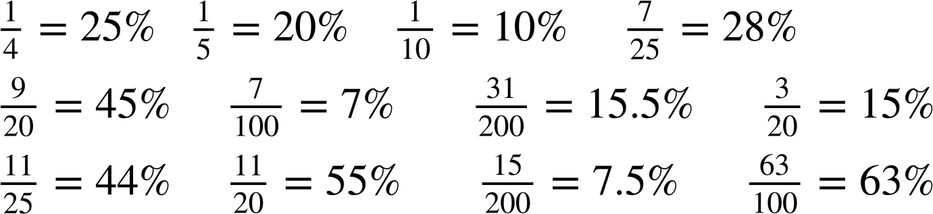
Writing any fraction as a percentage
Only shade in the equivalent percentages of the following fractions.
25% | 20% | 5% | 31% | 11% | 15%
10% | 20% | 17% | 5% | 15.5% | 17%
2% | 8% | 13% | 7% | 8% | 5%
31% | 4% | 45% | 14% | 6% | 8%
29% | 28% | 23% | 11% | 44% | 55%
10% | 21% | 59% | 3% | 7.5% | 63%

Slide 23

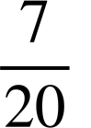
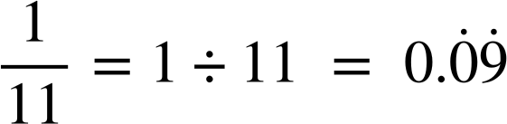
Writing any fraction as a percentage
2) Convert the following fractions into a percentage. Give your answers correct to 1 decimal place if needed.
a) b)
c) d)

Slide 24
Writing any fraction as a percentage
Only shade in the equivalent percentages of the following fractions.
25% | 20% | 5% | 31% | 11% | 15%
10% | 20% | 17% | 5% | 15.5% | 17%
2% | 8% | 13% | 7% | 8% | 5%
31% | 4% | 45% | 14% | 6% | 8%
29% | 28% | 23% | 11% | 44% | 55%
10% | 21% | 59% | 3% | 7.5% | 63%
25% | 20% | 5% | 31% | 11% | 15%
10% | 20% | 17% | 5% | 15.5% | 17%
2% | 8% | 13% | 7% | 8% | 5%
31% | 4% | 45% | 14% | 6% | 8%
29% | 28% | 23% | 11% | 44% | 55%
10% | 21% | 59% | 3% | 7.5% | 63%

Slide 25
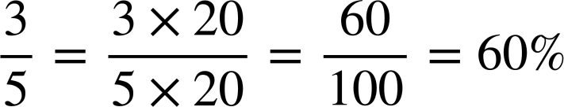
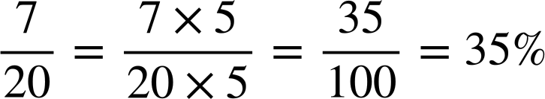


Writing any fraction as a percentage
2) Convert the following fractions into a percentage. Give your answers correct to 1 decimal place if needed.
a) b)
.
.
0
3
5
20 7
0
6
.
5 3
.
0
7
10
3
0
0

Slide 26


Writing any fraction as a percentage
2) Convert the following fractions into a percentage. Give your answers correct to 1 decimal place if needed.
c) d)
.
.
0
0
9…
0
9
11 1
0
1
2
5
.
8 1
.
1
10
1
10
1
2
4
0
0
0
0
0
0
0

Slide 27
Expressing one number as a percentage of another
Writing any fraction as a percentage
Writing any number as a percentage of another

Slide 28

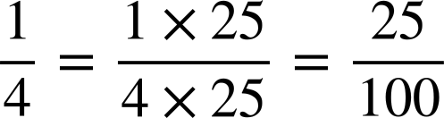
Writing any number as a percentage of another
What percentage of 40 is 10?
40
30
10
10 is of 40
10 is 25% of 40
10

Slide 29
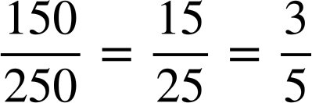
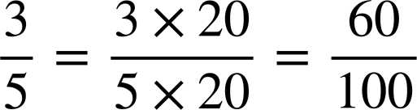
Writing any number as a percentage of another
What percentage of 250 is 150?
150 is of 250
We also know:
250
150
150
Converting this into a %
150 is 60% of 250

Slide 30

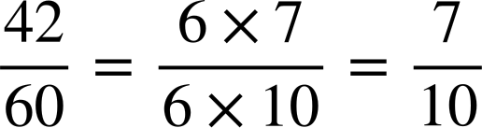
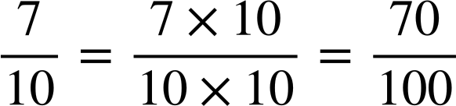
Writing any number as a percentage of another
What percentage of 60 is 42? You can use vertical bars to help.
42 is of 60
We also know:
60
42
42
Converting this into a %
42 is 70% of 60

Slide 31
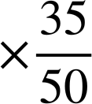
Writing any number as a percentage of another
We could represent this type of problem on a double number line. What percentage of 50 is 35?
70%
?
100%
Percentage
Amount
35
50
35 is 70% of 50
×
?

Slide 32
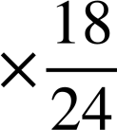
Writing any number as a percentage of another
What percentage of 24 is 18?
75%
?
100%
Percentage
Amount
18
24
18 is 75% of 24
×
?

Slide 33
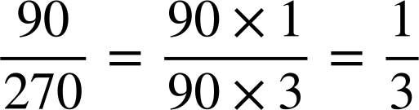
Writing any number as a percentage of another
Without representation, we can simply write the number as a fraction of its whole. For example, write 90 as a percentage of 270.
Write as a fraction
.
Simplify
0
3
3
3…
.
3 1
1
1
1
0
0
0
Convert to a percentage
90 as a percentage of 270 is 33.3% (1 d.p.)

Slide 34
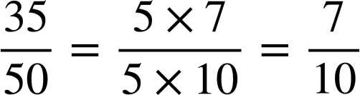
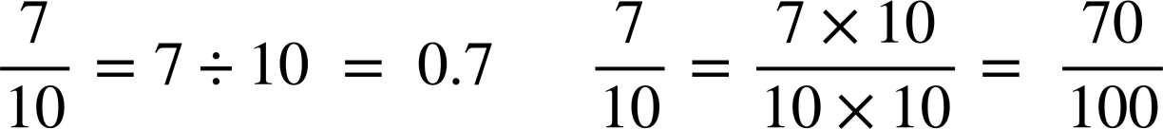
Writing any number as a percentage of another
Write 35 as a percentage of 50
.
0
7
Using short division
10 7
.
0
7
35 as a percentage of 50 is 70%

Slide 35
Writing any number as a percentage of another
Write 35 as a percentage of 50
Using equivalent fractions
35 as a percentage of 50 is 70%

Slide 36
Writing any number as a percentage of another
Work out the following, giving your answer to 2 d.p. where appropriate:
21 as a percentage of 25
60 as a percentage of 80
84 as a percentage of 240
81 as a percentage of 240
37 as a percentage of 60
19 as a percentage of 40

Slide 37
Writing any number as a percentage of another
2) Laura is ill and misses her first day of school.
a) What is her percentage attendance after day one?
Laura is better the next day and attends school.
b) What is her percentage attendance after day two?
Laura attends the rest of that week and all of the next week.
c) What is her percentage attendance after day five?
d) What is her percentage attendance after day ten?
Laura says that she will need to attend every day for the rest of the year to get 100% attendance.
e) Is Laura correct? Why or why not?

Slide 38
Writing any number as a percentage of another
Work out the following, giving your answer to 2 d.p. where appropriate:
21 as a percentage of 25
60 as a percentage of 80
84 as a percentage of 240
81 as a percentage of 240
37 as a percentage of 60
19 as a percentage of 40
84%
75%
35%
33.75%
61.67% (2 d.p.)
47.5%

Slide 39
Writing any number as a percentage of another
2) Laura is ill and misses her first day of school.
a) What is her percentage attendance after day one?
Laura is better the next day and attends school.
b) What is her percentage attendance after day two?
Laura attends the rest of that week and all of the next week.
c) What is her percentage attendance after day five?
d) What is her percentage attendance after day ten?
0%
50%
80%
90%

Slide 40
Writing any number as a percentage of another
Laura says that she will need to attend every day for the rest of the year to get 100% attendance.
e) Is Laura correct? Why or why not?
No, Laura is not correct – she cannot get 100% attendance for the year, as she has already missed a day.
The highest Laura’s attendance can be, to the nearest whole number, is 99% (as 189 ÷ 190 × 100 = 99.473684…). The lowest Laura’s attendance could be is 5% (as 9 ÷ 190 × 100 = 4.736842…)

Slide 41
Expressing one number as a percentage of another
We have looked at how to write any fraction as a percentage.
If the denominator is a factor of 100, we can work out the equivalent percentage easily.
We can also convert a fraction to a decimal and then convert this into a percentage for any fraction.
There are lots of ways we can make sense of writing one number as a percentage of another. In this lesson we looked at vertical bars, double number lines and using equivalent fractions.

Slide 42

© Oak National Academy 2024.
Produced in partnership with Mathematics in Education and Industry.
Licensed on the Open Government Licence v3.0, except where otherwise stated. See Oak terms and conditions.

